Slide 1
Machine Learning Techniques Week II
Lecturer : Mr. Hel Chanthan
Student : Chek Nita

Slide 2
Planning
Week I
Introducing to Machine Learning
Done
Week II
Machine Learning Techniques
In Progressing
Week III
Lab and Include own project
In Progressing
Week IV
Own Project
In Progressing

Slide 3
Outline
Machine learning techniques
Regression
Simple Linear regression
Multiple Linear regression
Classification
K-Nearest Neigbor
Decision Tree
Logistic Linear
Clustering
Recommender Systems

Slide 4
Machine Learning Techniques
Machine Learning techniques :
Regression/Estimation
Predicting continuous values
Classification
Prediction the item class/ category of a case
Clustering
Finding the structure of data / summarization
Associations
Finding item that co-occur
Anomaly detection
Discovering abnormal and unusual case
Sequence mining
Predict next events
Dimension Reduction
Reducing the size of data
Recommendation systems
Recommending items

Slide 5
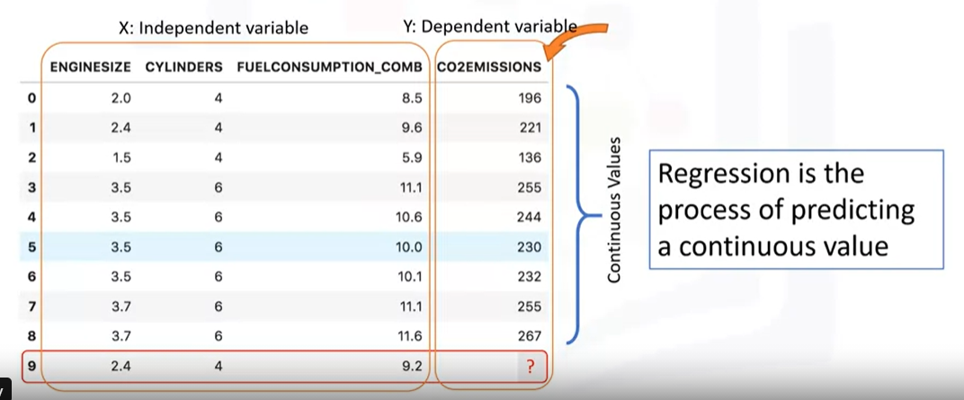
Regression
What is Regression ?

Slide 6
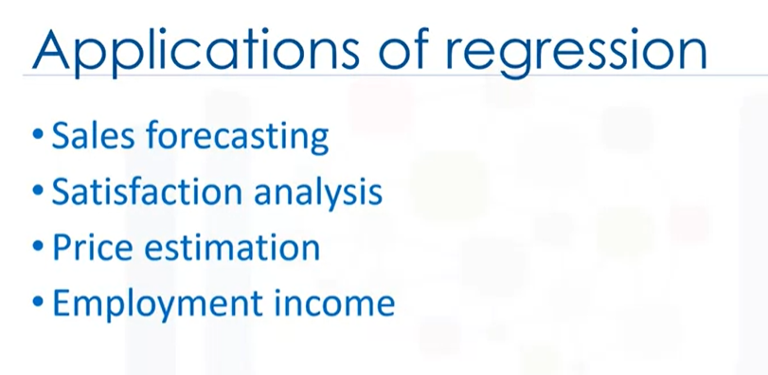
Regression
Type of Regression models :
Simple Linear Regression
Simple Linear Regression
Simple Non-Linear Regression
Multiple Linear Regression
Multiple Linear Regression
Multiple Non linear Regression

Slide 7
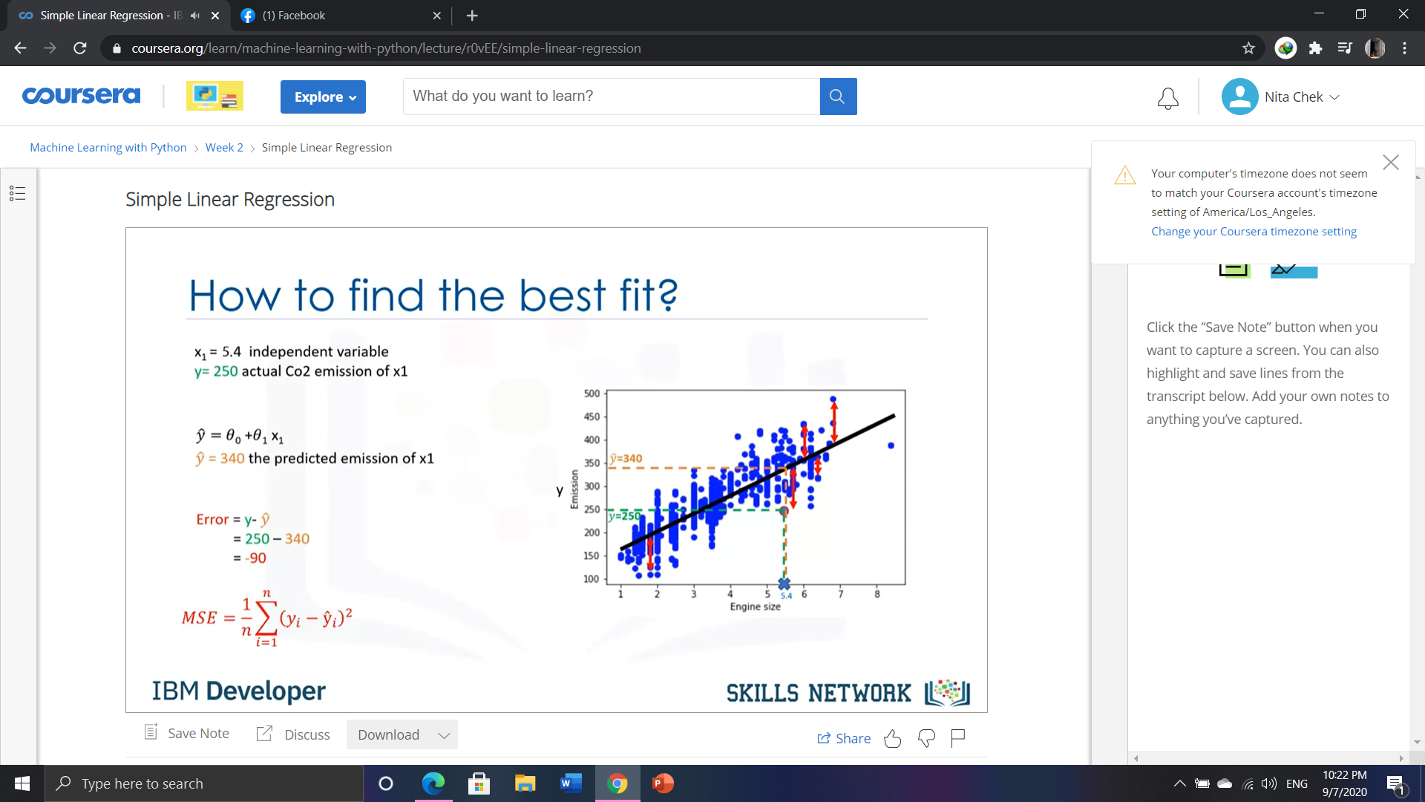
Simple Linear Regression

Slide 8
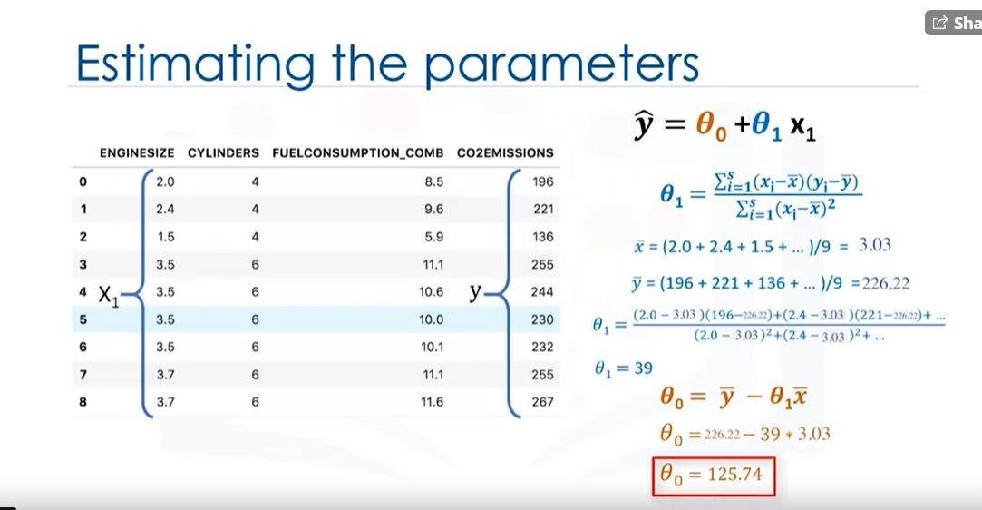
Simple Linear Regression

Slide 9
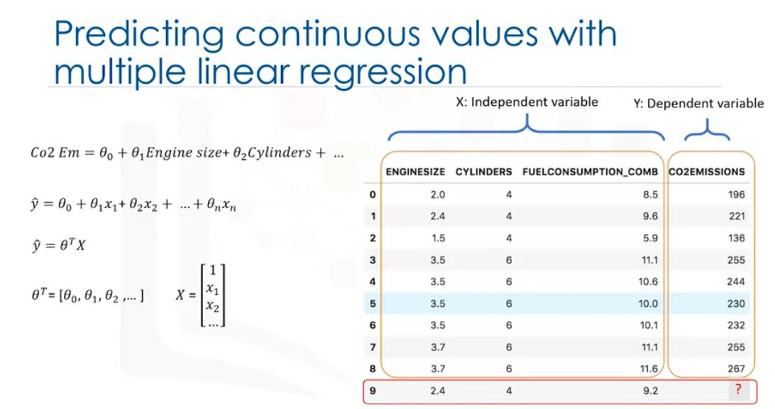
Multiple Linear Regression

Slide 10
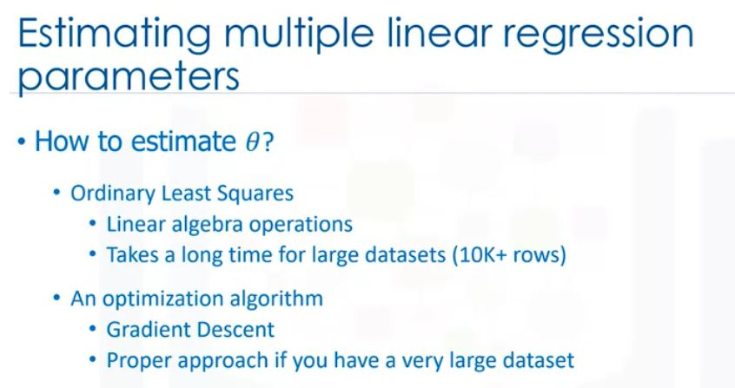
Multiple Linear Regression

Slide 11
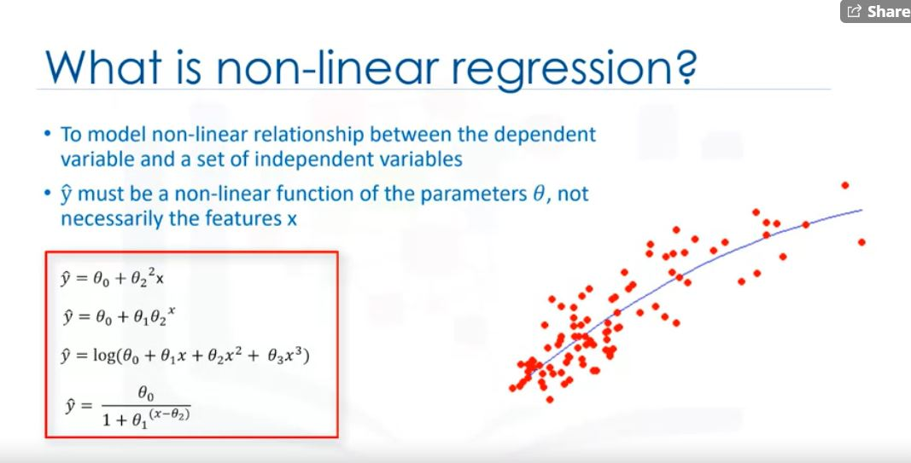
Non-Linear Regression

Slide 12
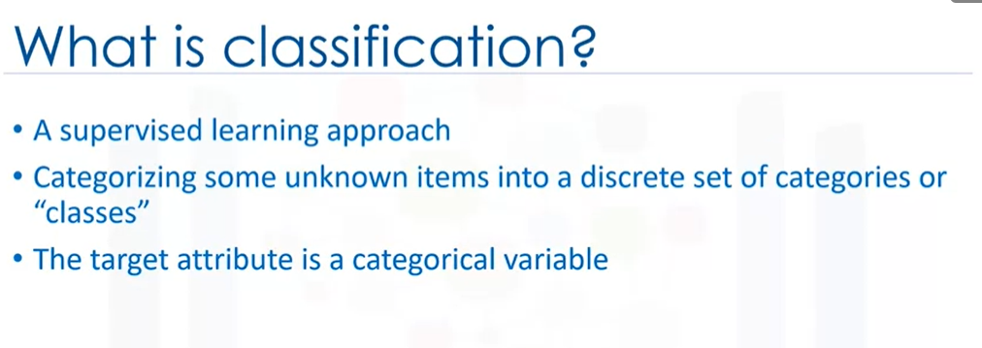
Classification

Slide 13
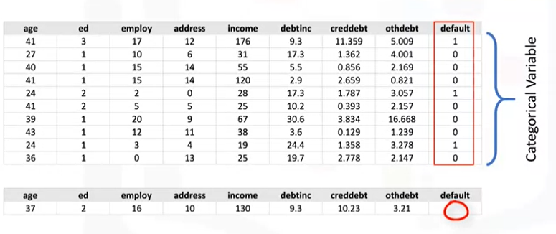
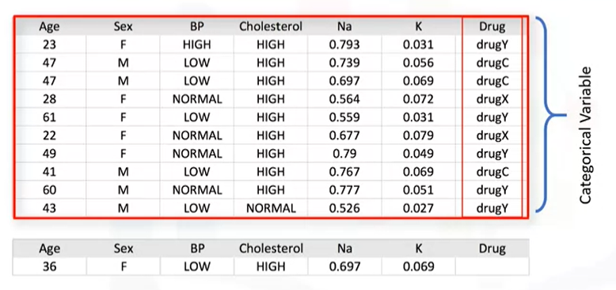
Classification
Normal
Multiple

Slide 14
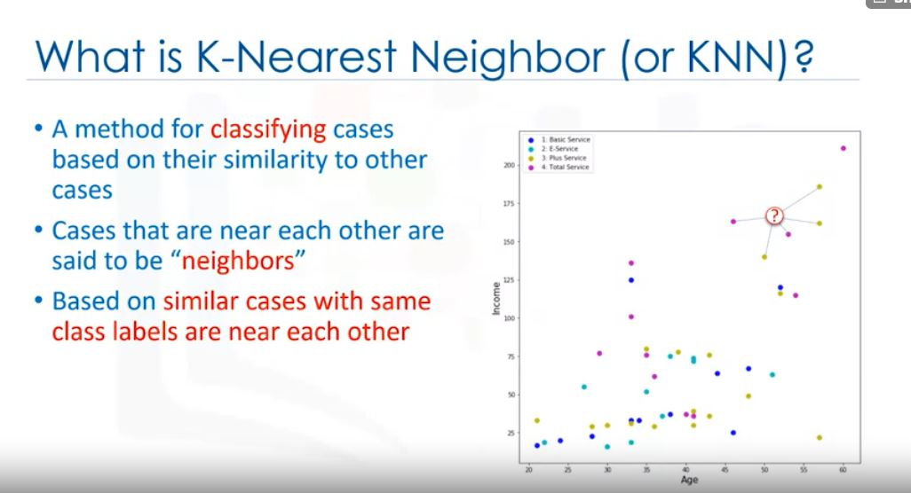
K-Nearest Neigbor

Slide 15
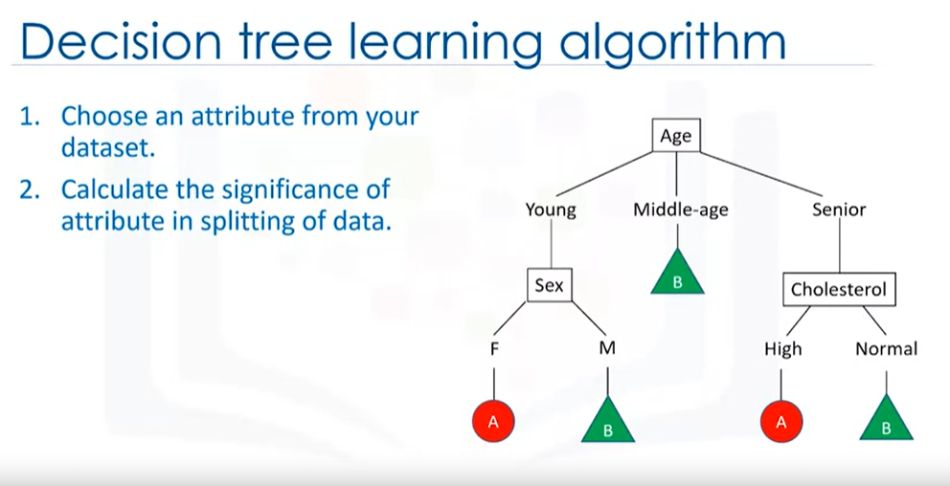
Decision Tree

Slide 16
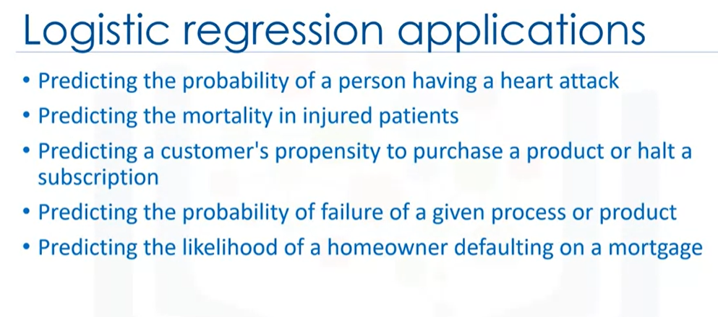
Logistic Regression

Slide 17
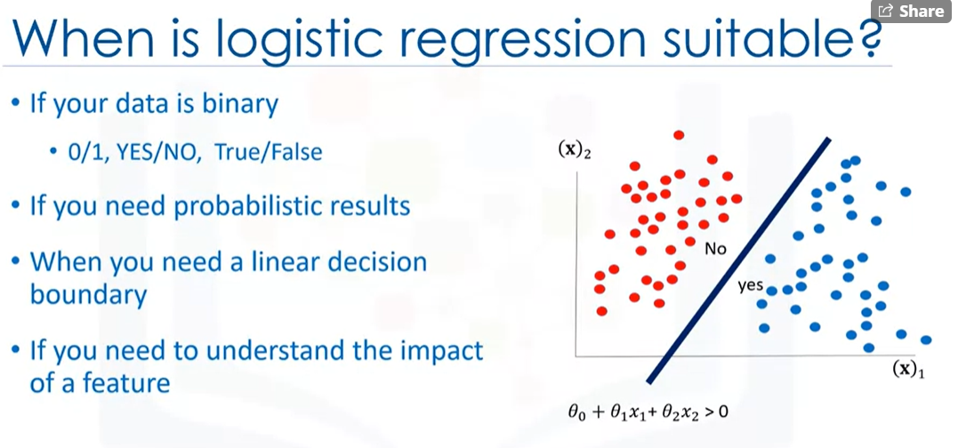
Logistic Regression

Slide 18
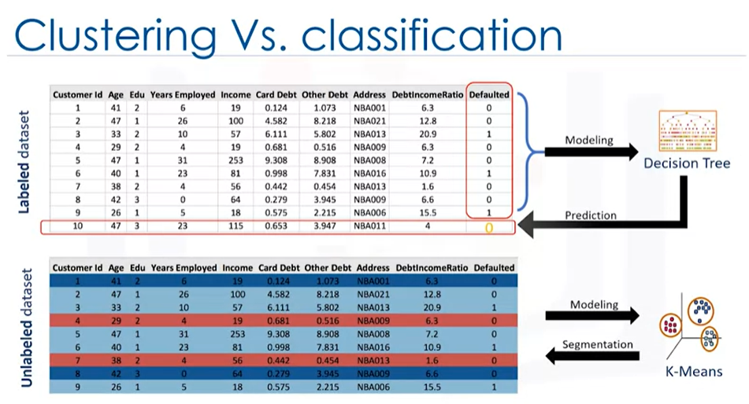
Clustering
Clustering is similar to regression and classification but mostly use for unlabeled dataset.

Slide 19
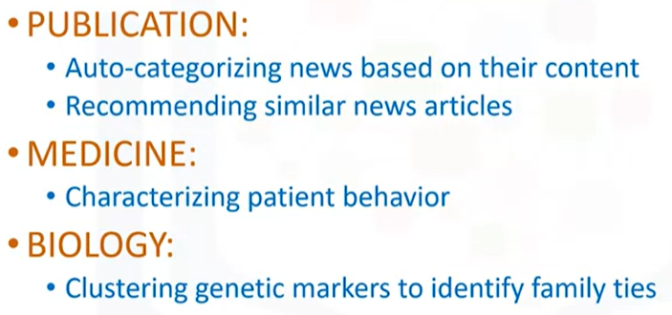
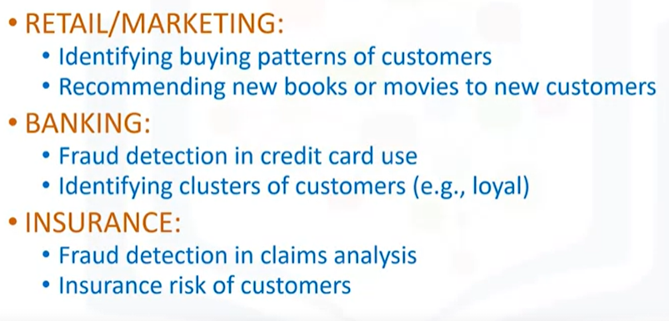
Clustering Applications

Slide 20
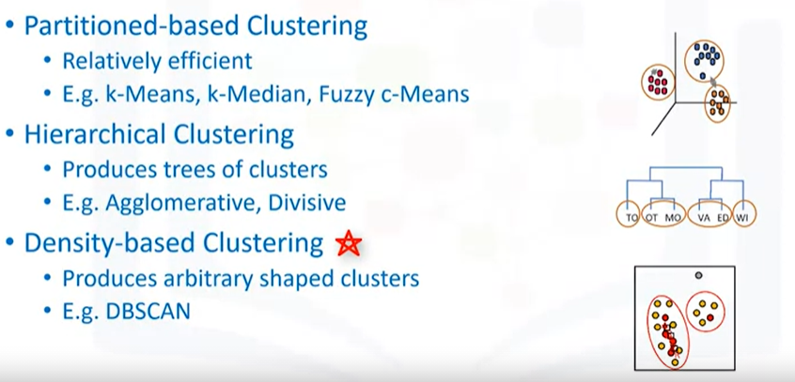
Clustering Algorism

Slide 21
Recommender Systems
Recommender systems capture the pattern of peoples’ behavior and use it to predict what else they might want or like.
Type of recommender systems :
Content-Based recommendation
Collaborative Filtering

Slide 22
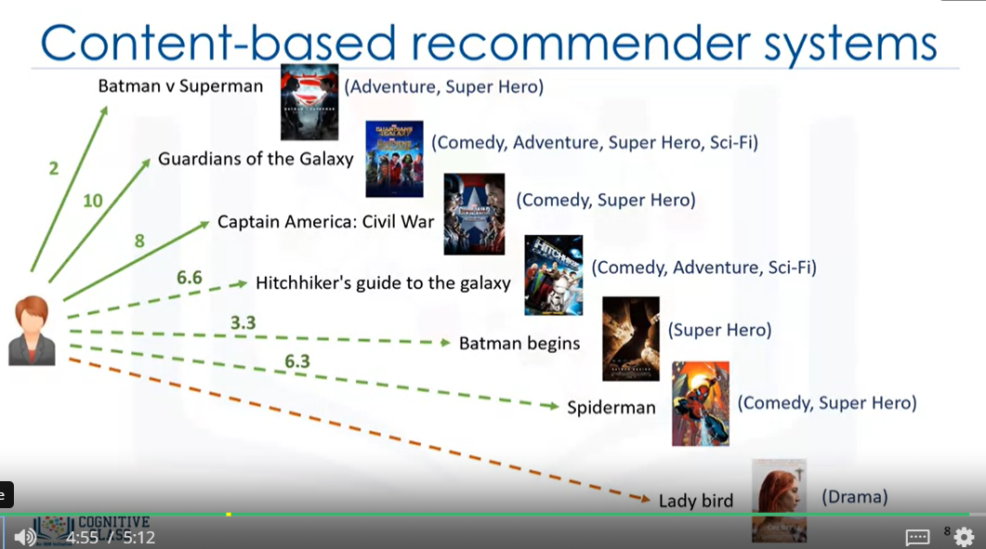
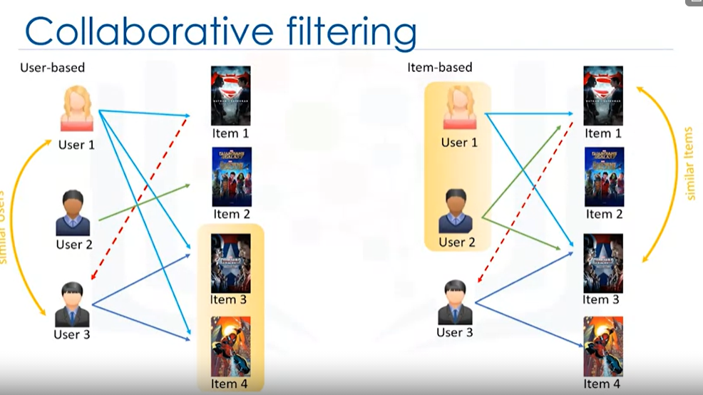
Content-based vs Collaboration

